Slide 1

CC 141 Discrete Structures Department of Computer Science School of Systems and Technology University of Management and Technology Lahore, Pakistan

Slide 2
Section 2.1 Sets

Slide 3
Set … The Definition
Sets are used to group objects together. Often the objects in a set have similar properties
A set is an unordered collection of objects
Example:
Students in the class: {Ahmad, Sana, Ali, Shahbaz, Farah}
Cities in Punjab: {Lahore, Faisalabad, Gujranwala, Jehlam}
Set of Integers: { … , -3, -2, -1, 0, 1, 2, 3, … }

Slide 4
Set Membership
The objects in a set are called the elements, or members, of the set.
a is an element of the set A, denoted by a ∈ A.
a is not an element of the set A, denoted by a ∉ A.
Example:
Set D: all students taking Discrete Mathematics course. Assume Bill is taking Discrete Mathematics course and George is not taking Discrete Mathematics course.
Bill ∈ D
George ∉ D

Slide 5
Expressing Set
There are many ways to express the sets
Listing all the elements
Set builder notation
Venn diagrams

Slide 6
Listing all elements
S = {e1 , e2 , e3 ,…,en }
where 𝑒_{𝑖} is element in the set
Example
All vowels in the English alphabet.
V = {a, e, i , o, u}
Odd positive integers < 10.
O = {1, 3, 5, 7, 9}
Positive integers less than 100.
{1, 2, 3, …, 99}

Slide 7
Set builder notation
Describe the properties the elements must have to be members
S = {x | P(x)}
S contains all the elements which make the predicate P true
Example:
R = { x | x is integer < 100 and > 40}
Z+ = { x | x is a positive integer}
O= {1,3,5,7,9} write set builder notation.

Slide 8
Important Sets
N = {0,1,2,3,…} , Set of natural numbers
Z = {…,-2,-1,0,1,2,…}, Set of integers
Z + = {1,2,3,…} , Set of positive integers
Q = {p/q | p ∈ Z, q ∈ Z, and q ≠ 0}, Set of rational numbers
R , Set of real numbers
Sets can have other sets as members
Example: The set {N, Z, Q, R} is a set containing four elements, each of which is a set.

Slide 9
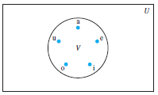
Venn diagrams
Sets can be represented graphically using Venn diagram.
Universal set U contains all objects under consideration say English alphabets
is represented by a rectangle
Other geometric figures are used to represent sets. Say set of vowels
Points are used to represent particular elements of sets. i.e. a, e, i, o, u
Show set A={a,b,c} using Venn diagram

Slide 10
Set equality
Two sets are equal if and only if they contain exactly the same elements. denoted by A = B.
Mathematically: A = B iff ∀x (x ∈ A ↔ x ∈ B)
Example: Are the following sets equal? Why &why not?
{1, 2, 3, 4} and {1, 2, 3, 4}
{1, 2, 3, 4} and {4, 1, 3, 2}
{a, b, c, d, e} and {a, a, c, b, e, d}
{a, e, i, o} and {a, e, i, o, u}

Slide 11
Set equality
Two sets are equal if and only if they contain exactly the same elements. denoted by A = B.
Mathematically: A = B iff ∀x (x ∈ A ↔ x ∈ B)
Example: Are the following sets equal? Why &why not?
{1, 2, 3, 4} and {1, 2, 3, 4} Yes
{1, 2, 3, 4} and {4, 1, 3, 2} Yes
{a, b, c, d, e} and {a, a, c, b, e, d} Yes
{a, e, i, o} and {a, e, i, o, u} No

Slide 12
Empty set, Singleton Set
A set that has no elements called empty set, or null set.
Denoted by {} , Ø. Example:
The set of all positive integers that are less than and equal to 0.
S = {x | x ∈ Z+ and x ≤ 0 } = {} = Ø
Singleton set: a set with one element
are Ø and {Ø} equal? No
Ф: an empty set. Think of this as an empty folder
{ф}: a set with one element. The element is an empty set. Think of this as a folder with an empty folder in it.

Slide 13
Cardinality of Set (Set Size)
The number of distinct elements in a set is known as its set size. For a set S, set size is denoted by |S|.
The size of a set is non-negative integer value
Set size is also called the cardinality of a set
Example:
Size of empty set is 0.
A be the set of odd positive integers less than 10, |A| =5
S be the set of letters in the English alphabet, |S| =?

Slide 14
Subsets
If A & B are two sets, A is called a subset of B, written A ⊆ B, if, and only if, all elements of A are also elements of B.
Symbolically:
A ⊆ B ⇔ if x ∊ A then x ∊ B
REMARK
When A ⊆ B, then B is called a superset of A.
When A is not a subset of B, then there exist at least one x ∊ A such that x ∉B.
Every set is a subset of itself.
B
A
U

Slide 15
Subsets … Examples
Let
A = {1, 3, 5}, B = {1, 2, 3, 4, 5}
C = {1, 2, 3, 4}, D = {3, 1, 5}
Then
A ⊆ B ( Because every element of A is in B )
C ⊆ B ( Because every element of C is also an element of B )
A ⊆ D ( Because every element of A is also an element of D and also note that every element of D is in A so D ⊆ A )
and A ⊈ C ( Because there is an element 5 of A which is not in C )

Slide 16
Exercise
x ∈ {x}
{x} ⊆ {x}
{x} ∈ {x}
{x} ∈{{x}}
∅ ⊆ {x}
∅ ∈ {x}
TRUE
TRUE
FALSE
TRUE
TRUE
FALSE

Slide 17
Proper Subsets
Let A and B be sets. A is a proper subset of B, if, and only if, every element of A is in B but there is at least one element of B that is not in A, and is denoted as A ⊂ B.
EXAMPLE
Let A = {1, 3, 5}, B = {1, 2, 3, 5} then
A ⊂ B (Because there is an element 2 of B which is not in A)
EXAMPLE
It is very easy to note that N ⊂ Z ⊂ Q ⊂ R ⊂ C

Slide 18
Set Equality
Two sets A and B are equal if, and only if, every element of A is in B and every element of B is in A. Equal sets are denoted as A = B.
Symbolically:
A = B iff A ⊆ B and B ⊆ A
EXAMPLE:
Given that A = {1, 2, 3, 6},
B = The set of positive divisors of 6,
C = {3, 1, 6, 2},
D = {1, 2, 2, 3, 6, 6, 6}
Then A, B, C, and D are all equal sets.

Slide 19
The power set
Let S be a set.
The power set of S is the set of all subsets of S, denoted by P(S).
If a set has n elements, then its power set has 2^{n} elements
Example:
P({a ,b }) = {Ø,{a},{b},{a ,b }}

Slide 20
Examples
How many elements do they have?
1. What is P({1,2,3})?
2. What is P({a, b, c, d})?

Slide 21
Power Set: Exercise
|P(∅)| = ?
|P(P(∅))| = ?
|P(P(P(∅)))|=?
If V = {a, e, i, o, u}, P(V)=? |P(V)|=?
If |X| = ∞, |P(X)|=?

Slide 22
Ordered n-tuple
The order of elements in a collection is often important.
Ordered n-tuple (a1 ,a2 ,... ,an ) is the ordered collection that has :
a1 as its first element
a2 as its second element
. . .
an as its nth element
Example: (a ,b ) is an ordered 2-tuple (ordered pair).

Slide 23
Ordered n-tuple
Let A=(a1, a2, …, an) and B=(b1, b2, …, bn) be ordered n-tuples.
A and B are equal if and only if each corresponding pair of their elements are equal, denoted by A=B.
A=B if and only a_{i} = b_{i} and for i = {1,2,…,n}
Example: Assume c ≠ b.
Are ordered 3-tuples (a ,b ,c ) and (a ,c ,b ) equal?

Slide 24
Cartesian Product
Let A and B be sets.
The Cartesian product of A and B, denoted by A × B, is the set of all ordered pairs (a, b), where a ∈ A and b ∈ B. Hence,
A × B = {(a, b) | a ∈ A ∧ b ∈ B}.
Example:
Cartesian product of A = {1, 2} and B = {a, b, c}?
A × B = {(1, a), (1, b), (1, c), (2, a), (2, b), (2, c)}.

Slide 25
Examples
Given A = {1, 2} and B = {a, b, c}
What are A x B and B x A?
A × B = {(1, a), (1, b), (1, c), (2, a), (2, b), (2, c)}.
B × A = {(a,1),(a,2),(b,1),(b,2),(c,1),(c,2)}
Are A x B and B x A equal?
A x B and B x A are equal if A = ∅ or B = ∅
(so that A x B = ∅) or A = B

Slide 26
Cartesian Product
The Cartesian product of sets A₁, A₂, …, A_{n}, denoted by A₁ × A₂ × … × A_{n} is the set of ordered n-tuples (a₁, a₂, …, a_{n}), where a_{i} belongs to A_{i} for i = 1,2, …, n.
In other words,
A₁ × A₂ × … × A_{n} = {(a1, a2, . . . , an) | a_{i} ∈ A_{i} for i = 1, 2, . . . , n}.

Slide 27
Cartesian Product (Examples)
Example:
What is the Cartesian product of A × B × C
where A= {0,1}, B = {1,2}, and C = {0,1,2}?
Solution:
A × B × C= {(0,1,0), (0,1,1), (0,1,2), (0,2,0), (0,2,1),
(0,2,2), (1,1,0), (1,1,1), (1,1,2), (1,2,0), (1,2,1), (1,2,2)}

Slide 28
Using Set Notation with Quantifiers
Using Set Notation with Quantifiers
∀x ∈S (P(x)) is shorthand for ∀x(x ∈ S → P(x)).
∃x ∈S (P(x)) is shorthand for ∃x(x ∈ S ∧ P(x)).

Slide 29
Example
What do the statements ∀ x ∈ R(x² ≥ 0) and ∃x ∈ A (x² = 1) where A= {1,2,3,4,5} mean?
Solution:
∀x ∈R (x² ≥ 0)= for every real number x, x² ≥ 0.
“The square of every real number is nonnegative.”
True
∃x ∈Z (x² = 1) = there exists an positive integer x less than 5 such that x² = 1.
True
“For x=1 from the given set A.”

Slide 30
Truth Sets and Quantifiers
Let P be a predicate and D is a domain.
The truth set of P is the set of elements x in D for which P(x) is true.
The truth set of P is {x ∈ D | P(x)}.

Slide 31
Truth Sets and Quantifiers
Example:
Let P(x) be |x| = 1 where the domain is the set of integers. What is the truth set of P(x)?
Solution: {-1,1}

Slide 32
Practice
Let Q(x) be x² = 2 where the domain is the set of integers. What is the truth set of Q(x)?
Let R(x) is “|x| = x.” where the domain is the set of integers. What is the truth set of R(x)?
Notes:
truth set of Q(x) is Ø.
truth set of R, is the set of integers for which |x| = x. |x| = x iff x ≥ 0, it follows that the truth set of R is N, the set of nonnegative
integers.

Slide 33
More Practice questions
Exercise 2.1:
Questions : 2,3,5,7,13,15,17,19,23,29,33,35

Slide 34
Section 2.2 Set Operations

Slide 35
Set operations
Two sets can be combined in many different ways.
Set operations can be used to combine sets.

Slide 36
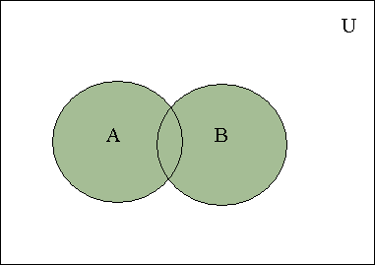
Union
Let A and B be sets.
The union of A and B, denoted by A ∪ B, is the set containing those elements that are either in A or in B, or in both.
A ∪ B = {x | x ∈ A ∨ x ∈ B}.
Example:
Find union of the sets {1, 3, 5} and {1, 2, 3}.
Solution: {1, 3, 5} ∪ {1, 2, 3} = {1, 2, 3, 5}.
A ∪ B=B ∪ A
Shaded area represents A U B.

Slide 37
Membership for Union
A | B | A ∪ B
1 | 1 | 1
1 | 0 | 1
0 | 1 | 1
0 | 0 | 0
Remember Disjunction Table
P | Q | P ∨Q
T | T | T
T | F | T
F | T | T
F | F | F
REMARK : This membership table for Union is similar to the truth table for logical connective, disjunction (∨)

Slide 38
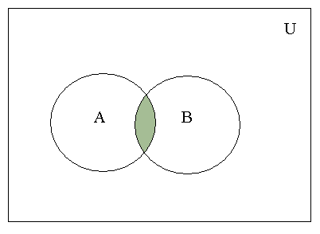
Intersection
Let A and B be sets.
The intersection of A and B, denoted by
A ∩ B, is the set containing those elements in both A and B.
A ∩ B = {x | x ∈ A ∧ x ∈ B}
Example:
Find intersection of the sets {1, 3, 5} and {1, 2, 3} Solution:
{1, 3, 5} ∩ {1, 2, 3} = {1, 3}.
A ∩ B= B ∩ A
Shaded area represents A ∩ B.

Slide 39
Set Operations … Membership Table
A | B | A ∩ B
1 | 1 | 1
1 | 0 | 0
0 | 1 | 0
0 | 0 | 0
Remember Conjunction Table
P | Q | P ∧ Q
T | T | T
T | F | F
F | T | F
F | F | F
REMARK : This membership table for Intersection is similar to the truth table for logical connective, conjunction (^)

Slide 40
Set Operations
A= {a, b, c} and B= {c, d, f}.
Find A ∪ B
Find A ∪ B=B ∪ A
Find A ∩ B
Is A ∩ B= B∩ A
Solution:
1) {a, b, c} ∪ {c, d, f} = {a, b, c, d, f}.
2) Yes
3) {c}
4) Yes

Slide 41
Disjoint Sets
Two sets are called disjoint if their intersection is the empty set.
Example;
Let A = {1, 3, 5, 7, 9} and B = {2, 4, 6, 8, 10}.
A ∩ B = ∅, thus A and B are disjoint

Slide 42
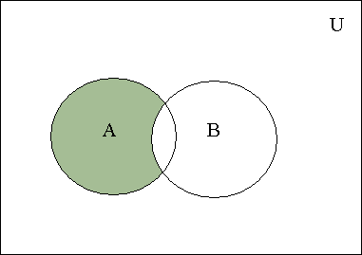
Difference
Let A and B be sets.
The difference of A and B, denoted by A-B, is the set containing those elements that are in A but not in
B. (also called complement of B with respect to A)
A − B = {x | x ∈ A and x ∉ B}
Example:
{1,2,3} - {2,4} = {1,3}
Find difference of {1, 3, 5} and {1, 2, 3}.
Find difference of {1, 2, 3} and {1, 3, 5},
A – B ≠ B – A
A – B is shaded.

Slide 43
Membership for Difference
A | B | A - B
1 | 1 | 0
1 | 0 | 1
0 | 1 | 0
0 | 0 | 0
Remember Implication Table
P | Q | P→Q | ¬(P→Q)
T | T | T | F
T | F | F | T
F | T | T | F
F | F | T | F
REMARK : This membership table for Difference is similar to the truth table for negation of Implication

Slide 44
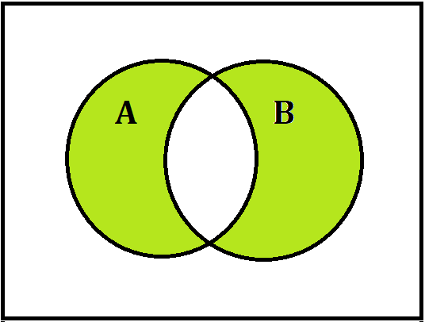
Set Operations … Symmetric Difference
Let A and B be subsets of a universal set U. The “symmetric difference of A and B” is the set of all elements in U that belong to either A or B but not both and is denoted A Δ B.
Symbolically:
A Δ B = {x ∈ U | x ∊ A-B OR x ∊ B-A}
EXAMPLE
Let U = {a, b, c, d, e, f, g}
A = {a, b, c, d, e}, B = {d, e, f, g}
Then A Δ B = {a, b, c, f, g}
U
REMARK
A Δ B = (A ⊕ B)
AΔB is shaded

Slide 45
Membership for Symmetric Difference
A | B | A Δ B
1 | 1 | 0
1 | 0 | 1
0 | 1 | 1
0 | 0 | 0
Remember XOR Table
P | Q | (P⊕ Q)
T | T | F
T | F | T
F | T | T
F | F | F
REMARK : This membership table for Difference is similar to the truth table for negation of Implication

Slide 46
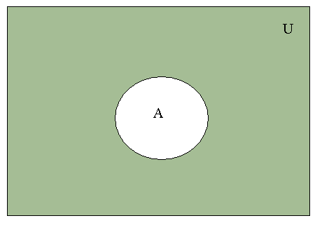
Complement of a Set
Let U be the universal set and A be a set.
The complement of A, denoted by Ā , is the complement of A with respect to U (which is U-A).
Ā = {x ∈ U | x ∉ A}.
EXAMPLE
Let U = {a, b, c, d, e, f, g]
A = {a, c, e, g}
Then A^{c} = {b, d, f}
Ā is shaded.

Slide 47
Membership Table for A^{c}
REMARKS
A^{c} = U – A
(A^{c})^{c} = A
A ∩ A^{c} = φ
A ∪ A^{c} = U
Membership Table for A^{c}
A | A^{c}
1 | 0
0 | 1
Membership Table for Negation
p | ¬p
T | F
F | T

Slide 48
Examples
A={a,b,c,d} and U is the set of English alphabet
Ā = {e,f,g,h,i,j,k,l,m,n,o,p,q,r,s,t,u,v,w,x,y,z}
Let A be the set of positive integers greater than 10 (with universal set the set of all positive integers). Find Ā.
Ā= = {1, 2, 3, 4, 5, 6, 7, 8, 9, 10}.

Slide 49
Summary of Set Operations
Let A and B be subsets of a universal set U. Recall the following definitions :
Union: A ∪ B = { x ∈U | x ∈A or x ∈ B}
Intersection: A ∩ B = { x ∈U | x ∈A and x ∈ B}
Difference: A – B = { x ∈U | x ∈ A and x ∉B}
Complement: A^{c} = { x ∈U | x ∉A}

Slide 50
Summary of Membership Tables
A | B | AUB | A∩B | A-B | A
1 | 1 | 1 | 1 | 0 | 0
1 | 0 | 1 | 0 | 1 | 0
0 | 1 | 1 | 0 | 0 | 1
0 | 0 | 0 | 0 | 0 | 1

Slide 51
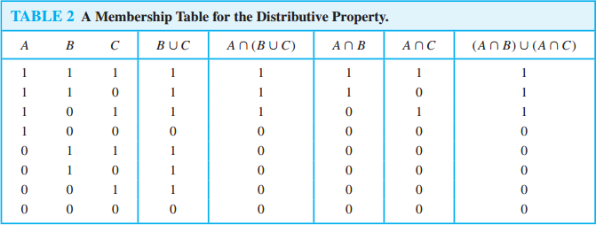
Membership Table Example
Use a membership table to show that
A ∩ (B ∪ C) = (A ∩ B) ∪ (A ∩ C).

Slide 52

Generalized Union
The union of a collection of sets is the set that contains those elements that are members of at least one set in the collection.
We use the notation
A₁ ∪ A₂ ∪ · · · ∪ A_{n} =
to denote the union of the sets A1, A2, . . . , An.

Slide 53

Generalized Intersection
The intersection of a collection of sets is the set that contains those elements that are members of all the sets in the collection.
We use the notation
A₁ ∩ A₂ ∩ · · · ∩ A_{n} =

Slide 54
Representation of Sets
Represent a subset A of U with the bit string of length n, where the ith bit in the string is 1 if a_{i} belongs to A and is 0 if a_{i} does not belong to A.
Example:
Let U = {1,2,3,4,5,6,7,8,9,10}, and the ordering of elements of U has the elements in increasing order; that is a_{i} = i.
What bit string represents the subset of all odd integers in U?
Solution: 10 1010 1010
What bit string represents the subset of all even integers in U?
Solution: 01 010 10101

Slide 55
Representation of Sets
Example:
Let U = {1,2,3,4,5,6,7,8,9,10}, and the ordering of elements of U has the elements in increasing order; that is a_{i} = i.
What bit string represents the subset of all integers not exceeding 5 in U?
Solution: 11 1110 0000
What bit string represents the complement of the set {1,3,5,7,9}?
Solution: 01 0101 0101

Slide 56
Representation of Sets
Union of bit string is bitwise OR
Intersection of bit string is bitwise AND of the bit strings for the two sets.
Example:
Bit strings for
{1,2,3,4,5} = 11 1110 0000 and
{1,3,5,7,9}=10 1010 1010.
Use bit strings to find the union and intersection of these sets.
Union:
11 1110 0000 V 10 1010 1010 = 11 1110 1010, {1,2,3,4,5,7,9}
Intersection:
11 1110 0000 Λ 10 1010 1010 = 10 1010 0000, {1,3,5}

Slide 57
Exercise 1
Let U = {1, 2, 3, …, 10}, X = {1, 2, 3, 4, 5}
Y = {y | y = 2 x, x ∈X}, Z = {z | z² – 9 z + 14 = 0}
Enumerate:
X ∩ Y (ii) Y ∪ Z (iii) X – Z
Y^{c} (v) X^{c} – Z^{c} (vi) (X – Z)^{c}

Slide 58
Exercise 2
Given the following universal set U and its two subsets P and Q, where
U = {x | x ∈ Z, 0 ≤ x ≤ 10}
P = {x ∈ U | x is a prime number}
Q = {x ∈ U | x² < 70}
Draw a Venn diagram for the above
List the elements in P^{c} ∩ Q

Slide 59
Exercise 3
Let U = {1, 2, 3, 4, 5}, C = {1, 4} and A and B are non empty sets. Find A in each of the following:
A ∪ B = U, A ∩ B = φ and B = {1}
A ⊂ B and A ∪ B = {3, 5}
A ∩ B = {4}, A ∪ B = {2, 3, 4} and B ∪ C = {1,2,3, 4}
A and B are disjoint, B and C are disjoint, and the union of A and B is the set {1, 2}.

Slide 60
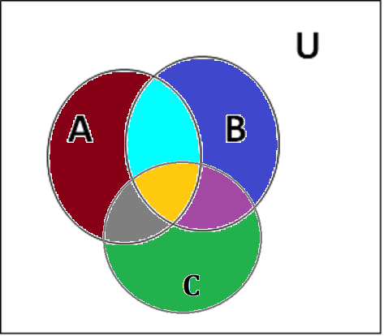
Venn Diagram
A way of graphically representing the elements of a set:
A box (rectangle) represents the universal set
A circle (disks) representing the sets
From the Venn diagram we can note:
Sets may intersect each other
A set may be the subset of other or not
If a set is the subset of the other then in VENN diagram the set is totally contained in the other set

Slide 61
Exercises… VENN Diagram
Problem
A number of computer users are surveyed to find out if they have a printer, modem or scanner. Draw separate Venn diagrams and shade the areas, which represent the following configurations:
Modem and printer but no scanner
Scanner but no printer and no modem
Scanner or printer but no modem
No modem and no printer

Slide 62
Exercises… VENN Diagram
Of 21 typists in an office, 5 use all types of typing accessories (M: manual typewriters, E: electronic typewriters and W: word processors; 9 use E and W; 7 use M and W; 6 use M and E; but no one uses M only.
Represent this information in a Venn Diagram
If the same number of typists use electronic as use word processors, then
How many use word processors only?
How many use electronic typewriters?

Slide 63
Exercises using VENN Diagram
In a school, 100 students have access to three software packages, A, B and C; 28 did not use any software; 8 used only packages A; 26 used only packages B; 7 used only packages C; 10 used all three packages and13 used both A and B:
Draw a Venn diagram with all sets enumerated as for as possible. Label the two subsets which cannot be enumerated as x and y, in any order
If twice as many students used package B as package A, write down a pair of simultaneous equations in x and y
Solve these equations to find x and y
How many students used package C?

Slide 64
Exercise … Venn Diagram
If U = {1, 2, 3, 4, 5, 6, 7, 8}, A = {1, 2, 4, 5},
B = {2, 3, 5, 6} and C = {4, 5, 6, 7} then
Use a Venn diagram to represent the following:
(A ∩ B) ∩ C^{c}
A^{c} ∪ (B ∪ C)
(A – B) ∩ C
(A ∩ B^{c}) ∪ C^{c}

Slide 65
Proving Set Identities By Venn Diagrams
Prove the following using Venn Diagrams:
A – (A – B) = A ∩ B
(A ∩ B)^{c} = A^{c} ∪ B^{c}
A – B = A ∩ B^{c}

Slide 66
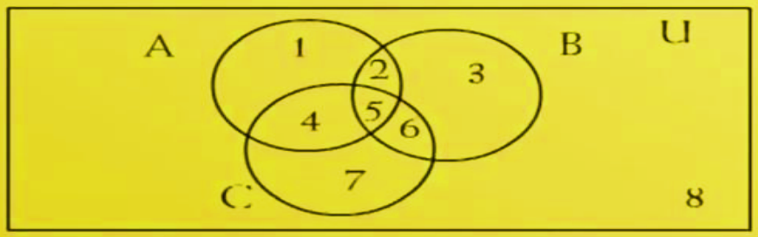
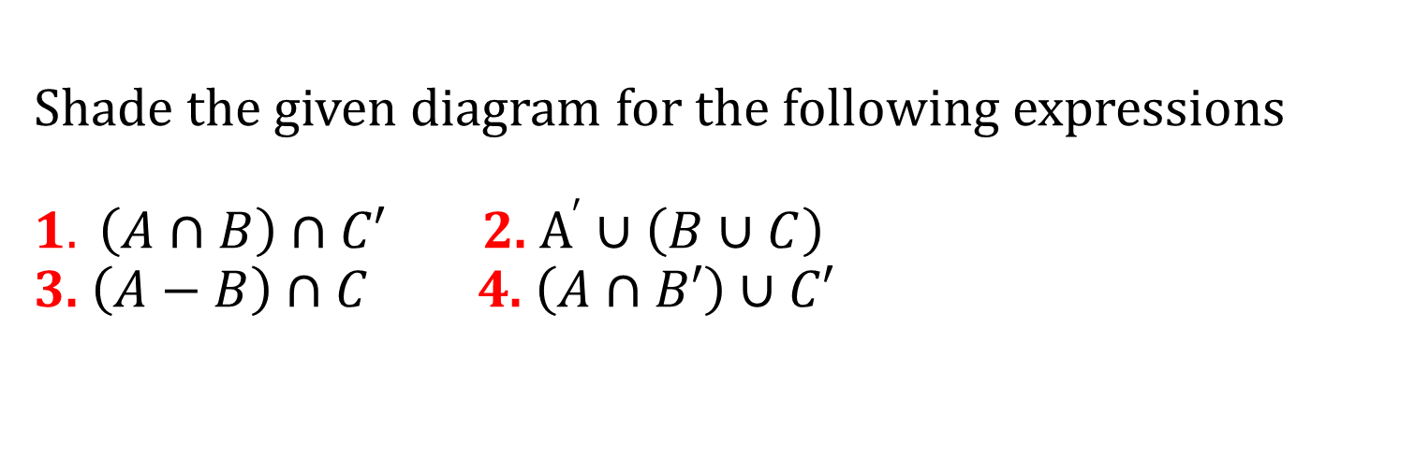
Shade the given diagram for the following expressions $1. \left(A∩B\right)∩C′$ 2. $A^{′}∪\left(B∪C\right)$ 3. $\left(A−B\right)∩C$ 4. $\left(A∩B′\right)∪C′$
Shading Venn diagrams with 3 sets

Slide 67
More Practice questions
Exercise 2.2:
Questions : 3,5,9,13,17,27,29

Slide 68

Summary
The topics we covered:
Intro to Sets
Expressing Sets
Subsets
Power Set
Cardinality of Sets
Cartesian Product
Set Operations
Membership Tables
Venn Diagrams
Practice Questions

